Slide 1
What would be the IV and DV in each of these examples?
Students went to the library and the canteen handing out word lists and asked people to learn them. They later tested the students on the lists.
IV – word lists
DV - (Score) memory
Students stood by the entrance to college and noted who held the door open for others more often, males or females.
IV – Male or female
DV – Open the door
A teacher asked half of her students to juggle in front of the class and counted how many times they dropped the balls. The other half of the class performed the same task but in private.
IV – in front of class or private
DV – how many balls dropped
Sports students and Psychology students had a high jump competition to see who could jump the highest.
IV – Sport vs Psychology
DV – Height of jump

Slide 2
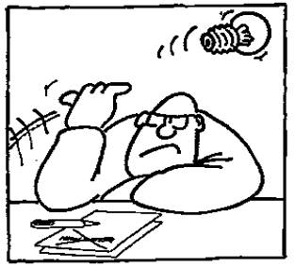
Planning an experiment
Component 01
Research Methods
C/W
L.O: To be able to explain the difference between a research questions and a hypothesis.

Slide 3
Progress Criteria
How will you know that you have made progress this lesson?
GOING STRONG
I can analyse the problems caused by extraneous variables and being to create my own experiment.
ACCELERATING
I can outline the difference between an alternate and null hypothesis, as well as write one-tailed and two tailed hypothesis.
REVVING UP
I can explain the difference between an aim and a hypothesis and write research aims.

Slide 4
What is the difference between a research aim and a hypothesis?
Aims are statements about what the researcher wants to investigate. Hypotheses are predictions about what the researcher expects to find.
REVVING UP

Slide 5
All research must have an aim:
The aim is a statement about what the researcher wants to investigate. It is usually kept quite broad and is written using the following format:
‘The aim of the research is to investigate ….’
REVVING UP

Slide 6
Writing Hypotheses
Hypotheses are statements about the prediction of the results. There are some general rules when formulating them. Typically they:
are written in the future tense
include both conditions of the independent variable
include the dependent variable.
REVVING UP

Slide 7
There are four types of hypotheses:
Null Hypotheses – these predict that no difference will be found in the results between the conditions. Typically these are written ‘There will be no difference…’
Alternative Hypotheses – these predict that there will be a significant difference in the results between the two conditions.
One tailed (directional) hypotheses – these state the specific direction the researcher expects the results to move in, e.g. higher, lower, more, less.
Two tailed (non directional) hypotheses – these state that a difference will be found between the conditions of the independent variable but does not state the direction of the results. Typically these are always written ‘There will be a difference ….’
ACCELERATING

Slide 8
Null
That there will be NO effect of X (IV) on Y (DV)
Aim: To investigate whether a happier dog will eat more food.
Null hypothesis – There will be no difference between the amount of food eaten by a happy dog and a sad dog.
REVVING UP

Slide 9
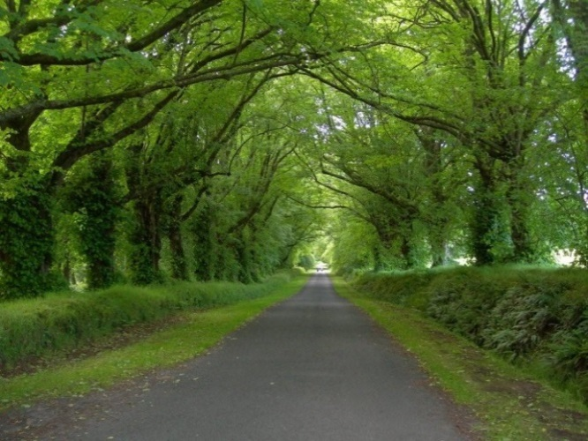
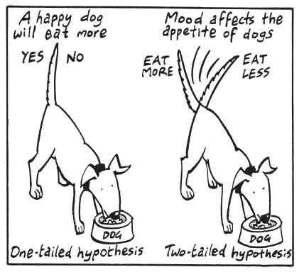
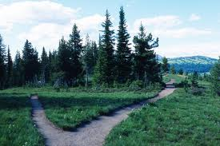
Alternate
That there will be an effect of X (IV) on Y (DV).
This can be divided into a one-tailed and a two-tailed hypothesis.
One tailed hypothesis (directional)
Predict the direction in which the results are expected to occur.
Two tailed hypothesis (non-directional)
simply state that there is some kind of difference between the two events.
Notes:
Null – no difference and no direction. Two tailed – difference but no direction and one-tailed has difference and direction.
There will be a significant difference between them but do not commit on the direction (men or women).
Football match – Man United v Norwich or Man United

Slide 10
Aim: To investigate performance of men and women on a memory Test.
What is the independent and dependent variable?
What is the null hypothesis?
Notes:
For every aim of an experiment we can give a null hypothesis. Independent variable – men and women. Dependent variable – score on the test.
Null hypothesis – no difference between men and women – any results are due to chance.

Slide 11
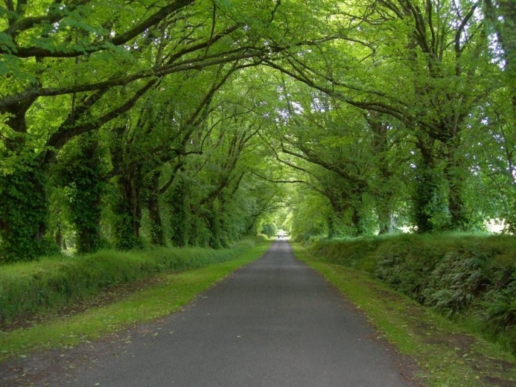
Alternate
That there will be an effect of X (IV) on Y (DV).
ACCELERATING
This can be divided into a one-tailed and a two-tailed hypothesis.
Men will recall significantly more words that Women on a memory test.
One tailed hypothesis (directional)
Predict the direction in which the results are expected to occur.
Two tailed hypothesis (non-directional)
simply state that there is some kind of difference between the two events.
Women
Men
There will be a significant difference between men and women but do not commit on the direction.
Notes:
Null – no difference and no direction. Two tailed – difference but no direction and one-tailed has difference and direction.
There will be a significant difference between them but do not commit on the direction (men or women).

Slide 12
Are these one or two tailed, null or alternate?
Boys will show more physical aggression than girls.
There will be a difference in happiness scores between people who work full time and those who work part time.
There will be no difference in the number of goals saved by goal keepers during a football match and during a training session.
The amount of alcohol drunk has an effect on reaction times.
One tailed alternative.
Two tailed alternative.
Null hypothesis.
Two tailed alternative.
Re-word these hypotheses so one-tailed become two-tailed and vice versa and that alternative become null.
Notes:
As an extension activity students could be asked to rephrase the hypotheses from the activity from one tailed to two tailed and then to write a corresponding null hypothesis and vice versa.

Slide 13
Extraneous variables
Anything that is not the independent variable that has the potential to affect the results is called an extraneous variable.
It can be a natural characteristic of the participant, such as intelligence levels, gender, or age for example, or it could be a feature of the environment such as lighting or noise.
This includes participant variables, situational variables, researcher effect and demand characteristics.
Task: Read through the extract and identify the extraneous variables.

Slide 14
There are many extraneous variables that could affect the results other than the monetary reward.
These include:
the amount of revision the student does
how many hours of lessons the students has a week
attendance percentage
the subjects the students are studying
the natural differences in ability of the student.
GOING STRONG

Slide 15
Designing an experiment
Begin planning and designing their own experiment using one of the 3 scenarios.
GOING STRONG
Notes:
Complete task 1-5, but not 3 as sampling hasn’t been covered yet.

