Slide 1
If I gave you a pack of smarties how would you eat them?

Slide 2
Sampling
G541: Psychological Investigations
C/W
L.O: To be able to explain what sampling is and the strengths and weaknesses of the 4 types of sampling.

Slide 3
How will you know that you have made progress this lesson?
Progress Criteria
GOING STRONG
I can apply the definitions to examples of experiments.
ACCELERATING
I can identify the strengths and weaknesses of the four types of sampling techniques and understand how they are used in research.
REVVING UP
I can explain what sampling is and why we need sampling in Psychology.

Slide 4
Which one of these questions represents how you would eat the smarties?
Who would choose to eat the smarties colour by colour?
Who would eat the ones that came out first?
Stratified sampling
Opportunity sampling
Who felt as though the smarties were calling at you ‘eat me, eat me’?
Who would put them into a big pot and close their eyes and select one with their hand?
Self-selecting sampling
Random sampling

Slide 5
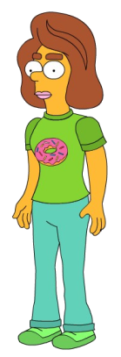
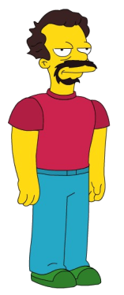
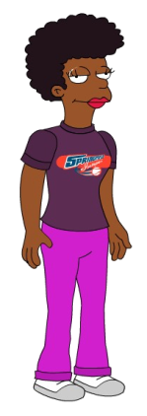
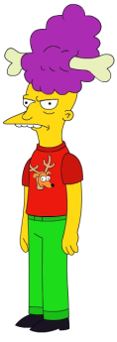
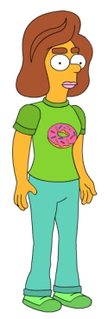
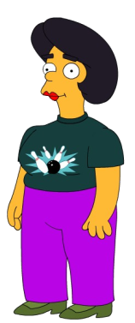
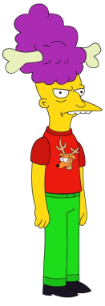
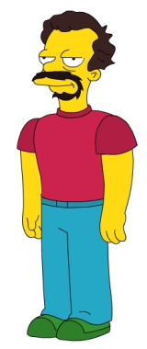
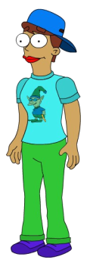
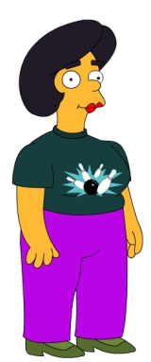
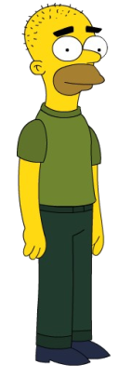
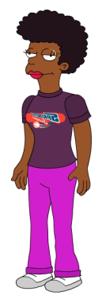
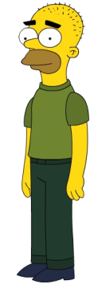
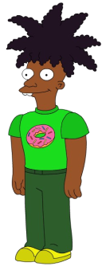
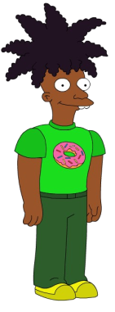
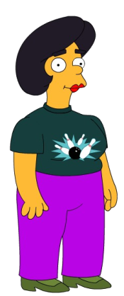
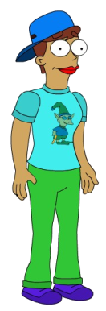
Sampling
One of the main aims of a research study is to be able to generalise from small samples as it is not possible to test everyone!
There are three technical terms to think about:
a) population
b) target population
c) sample
REVVING UP
Notes:
For example if the sample of participants are from Cheshunt Sixth Form, the findings of the study can only be applied to that group of people and not all sixth form students in the UK and certainly not all people in the world.

Slide 6
Sampling
REVVING UP
Definition of Population | Example
All the possible members of a group from which the sample will be taken | Cheshunt School Students
Definition of target Population | Example
The part of the population from which the sample is selected. | Cheshunt school students, in year 12 and 13 taking 4 A-Levels.
Definition of Sample | Example
The group selected from the target population for experiment or study. | The first 20 Cheshunt school students, in year 12 and 13 taking 4 A-Levels who walk into the common room.
Notes:
Only a definition of target population and sample is needed.

Slide 7
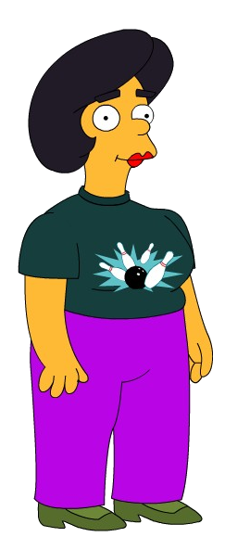
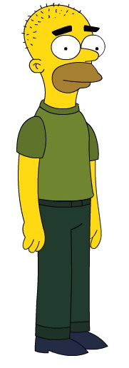
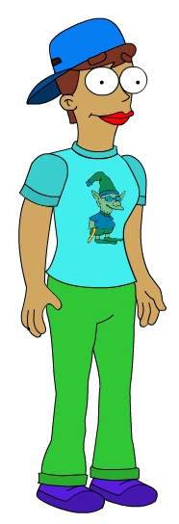
Obviously it is not usually possible to test everyone in the target population so therefore psychologists use sampling techniques to choose people who are representative (typical) of the population as a whole.
If your sample is representative then you can generalise the results of your study to the wider population.
=

Slide 8
Why do we need sampling?
In research one of the most important issues is that the results should be representative of the population.
Population is the group from whom the sample is drawn.
Not possible to test everyone – so we use a sample.
Psychologists choose people who are representative of the population.
REVVING UP

Slide 9
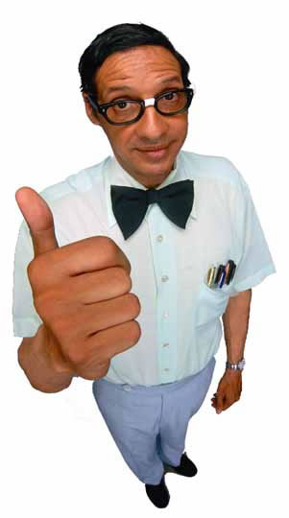
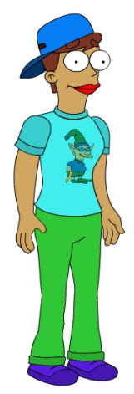
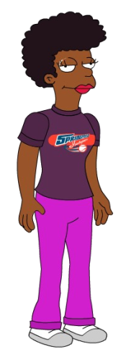
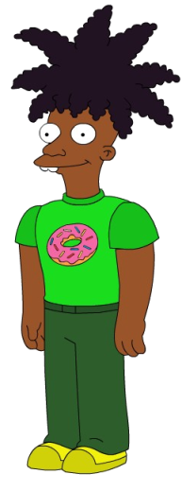
Opportunity Sampling
Want to be in my study?
Common Room
ACCELERATING
Opportunity sampling is the sampling technique most used by psychology students. This is the easiest, most common and cheapest method of sampling. It is simply about making use of the people that are readily available to you and willing to participate.

Slide 10
Identify the strengths and weaknesses
Strengths
+ It is a popular sampling technique as it is easy in terms of time and therefore money.
+ Good with quazi experiments when you have limited control.
Weaknesses
-Biased sample as it is easy for the researcher to choose people from their own social and cultural group. (Ethnocentric)
-Participants may decline to take part.
ACCELERATING

Slide 11
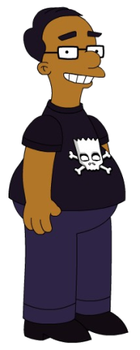
Random Sampling
Every member of the target population has an equal chance of being selected. The researcher needs the names of all members of their target population.
ACCELERATING
Notes:
This involves identifying everyone in the target population and then selecting the number of participants you need in a way that gives everyone in the population an equal chance of being picked

Slide 12
Identify the strengths and weaknesses
Strengths
+ Random sampling is the best technique for providing an unbiased representative sample of a target population.
Weaknesses
Random sampling can be very time consuming and is often impossible to carry out, particularly when you have a large target population, of say all students.
For example if you do not have the names of all the people in your target population you would struggle to conduct a random sample.
ACCELERATING

Slide 13
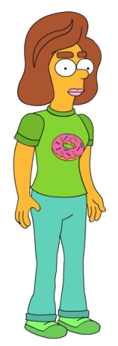
Stratified Sampling
= 60% female
40% male
Stratified sampling involves classifying the population into categories and then choosing a sample which consists of participants from each category in the same proportions as they are in the population.
ACCELERATING
= 60% female
40% male

Slide 14
Identify the strengths and weaknesses
Strengths
+The strength of stratified sampling is that your sample should be representative of the because it mirrors the percentage of the population.
Weaknesses
-However, stratified sampling can be very time consuming as the categories have to be identified and calculated.
-As with random sampling, if you do not have details of all the people in your target population you would struggle to conduct a stratified sample.
ACCELERATING

Slide 15
Self-selected Sampling
I just love to be helpful….
Volunteers needed for psychological study on learning
I’ve always wanted to be in a study….
Sounds rubbish…
Gotta do my hair..
Psych Lab
People who want to take part in research volunteer themselves. The psychologist will place an advert (this could be a poster, a flyer distribution, a TV advert, mail out, etc) then people interested in the study would reply to the advert.
ACCELERATING

Slide 16
Identify the strengths and weaknesses
Strengths
+ This technique, like opportunity sampling, is useful as it is quick and relatively easy to do.
+It can also reach a wide variety of participants.
Weaknesses
However, the type of participants who volunteer may not be representative of the target population for a number of reasons.
For example, they may be more obedient, more motivated to take part in studies and so on.
ACCELERATING

Slide 17
Snowball Sampling
Yes..on occasion
Sure, I’ll ask Sue too
Do you smoke Marijuana?
Sure.
Steve, will you be willing to do some research about the effects of smoking marijuana?
Sue, will you be willing to do some research about the effects of smoking marijuana?
Yes, I’ll ask Steve.
Will you be willing to do some research about the effects of smoking marijuana?
Great, do you know anyone else who might be willing?
Happy to help
ACCELERATING
Snowball sampling can be used if your population is not easy to contact. A snowball sample is achieved by asking a participant to suggest someone else who might be willing or appropriate for the study

Slide 18
Checking your understanding of samples and sampling methods
Look at the scenarios below, firstly identify which sampling method you think has been used and then outline any strengths or weaknesses you can see with the samples.
A researcher wanted a selection of gym members to take part to see how many hours on average people attended the gym per week. The gym manager put all the names of the gym members from 3 Fitness First gyms in Liverpool in to a hat and picked out 20 to take part in their investigation.
A researcher wanted to find out why people use public transport rather than cars. So he stood at a local train station in Sheffield and asked the first 50 people who were waiting to catch the train to answer his questions.
An English teacher is undertaking research in to how well students remember poems whilst listening to music compared to not listening to music. She advertises for participants on the student notice board and leaves an email address for students to respond to. She used the first 50 students who replied to take part in her experiment which consisted of 37 females and 13 males.
GOING STRONG
Notes:
1. Random.
Only used gym members from Fitness First so may not be representative of other people who use other gyms, also only used gyms in Liverpool so can only generalise findings to this area of the country.
2. Opportunity.
Only used people catching the train so didn’t ask people who used other methods of public transport, also only used people from Sheffield so can’t generalise findings about public transport use to people. The time of day he was there would also attract a certain type of person.
3. Self-selected.
The sample is gender biased; there are 37 females and only 13 males, therefore generalisation of results may not be appropriate.

Slide 19
A researcher wants to investigate lunch time eating habits (do people eat sandwiches or prefer hot food, how often do they eat out etc). He walks in to 3 different restaurants in Manchester; Zizzi, Bella Italia and Wagamama between 12pm – 1pm to find participants to ask about their eating habits.
A psychologist wants to find out how often homeless people make use of sheltered accommodation in the winter months, compared to the summer months. He approaches two homeless men in Bristol city centre and asks them his questions then he asks them to suggest other homeless people who may be willing to take part in his investigation and where he can find them.
GOING STRONG
Notes:
4. Opportunity.
Only used people from Manchester so biased to that area, also only went in to three restaurants which may not be the places that most people would eat at for their lunch, as they wouldn’t have time to sit down and order the food.
5.Snowball.
Only used homeless people in Bristol city centre and didn’t study homeless people from any other areas.

