Slide 1
What are the key elements of maths that you need to focus on? Use red pens to correct your maths exam.

Slide 2
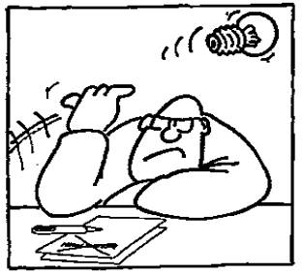
1.1 Research Methods and Techniques
Component 01
Research Methods
C/W
L.O: To be able to explain the different research methods and their associated strengths and weaknesses.

Slide 3
Progress Criteria
How will you know that you have made progress this lesson?
GOING STRONG
I can evaluate the strengths and weaknesses of the experimental method and experimental designs.
ACCELERATING
I can explain the difference between the independent and dependent variable and how they are operationalised.
REVVING UP
I can explain the different methods used for conducting research in psychology and what the experimental method is.

Slide 4
Why are Research Methods Important?
It is important that we understand how valid and reliable research and theories are.
Without scientific psychological investigations we have no way of really knowing the truth about how humans think and behave.
There is no one perfect method though, so we need to be able to describe each method and understand the strengths and weaknesses of each method.
Research Methods allow us to understand and evaluate the Core Studies.
They also allow us to better judge how true and accurate the statements of the media, politicians, advertisers and scientists really are.

Slide 5
We will look at four research methods:
Experiment.
Self-report.
Observation.
Correlation.
REVVING UP

Slide 6
Non-experimental research methods
Surveys (questionnaires, intelligence tests, personality tests…)
Naturalistic observation
Case studies (when one person’s case is followed)
REVVING UP

Slide 7
Experiments require…
Controlled conditions
An Independent Variable that the researcher can manipulate
Dependent Variable that the researcher can measure
At least two conditions for the independent variable
REVVING UP

Slide 8
Independent variables (IV)
The IV is the variable that is manipulated to see what effect it has on the Dependent Variable (DV)
The researcher needs to manipulate the variable, otherwise it is not “independent”
ACCELERATING

Slide 9
Are these variables “independent”?
Gender of the participants
Type of words participants are asked to recall
Age of participants
Height of participants
Types of pictures shown to the participants
Number of languages spoken by the participants
ACCELERATING
Notes:
Yes!

Slide 10
IV and conditions
Manipulating an IV means that you will have at least two conditions of the IV, in order to be able to measure its impact on the DV
For example:
Aim: do colors impact memory?
IV: colour of paper on which words to recall are printed
Conditions: each colour is a condition; at least 2 are needed
ACCELERATING

Slide 11
Dependent Variable (DV)
The DV is the variable that is affected by the IV
It must be measurable for an experiment to be valid
ACCELERATING

Slide 12
Operationalization
You should operationalize both your IV and your DV
For the IV, it means that you should find a way to manipulate it.
For the DV, it means that you should find a way to make it measurable.
ACCELERATING

Slide 13
Exercise: Operationalize the IV and DV
Aim of the study: Does eating a substantial breakfast affect students’ memory?
IV:
Conditions of the IV:
DV:
Measurement of the DV:
ACCELERATING

Slide 14
Exercise: Operationalize the IV and DV
Aim of the study: Do different types of music affect people’s IQ?
IV:
Conditions of the IV:
DV:
Measurement of the DV:
ACCELERATING

Slide 15
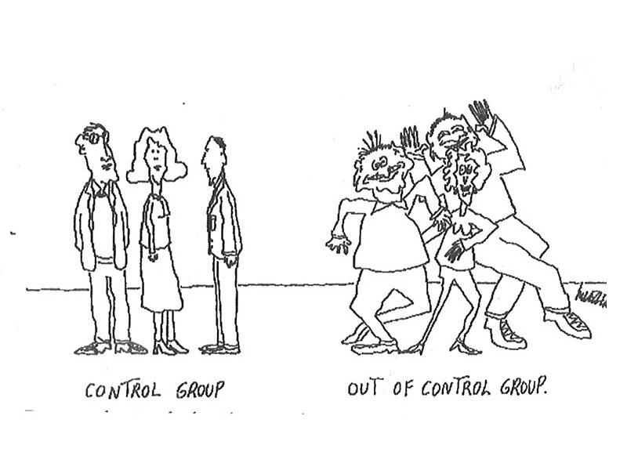
Control
The groups that are beings experimented on are called experimental groups. In the case of repeated measures, when the sample is being experimented on, we talk about experimental condition.
In most experiments, there is also a control group or control condition to test what happens, for instance, when the same task is performed in a fairly natural situation.

Slide 16
No control
Sometimes, the conditions of the IV act as control for each other and there is no need for a control condition or group.
For example: an experiment on whether people memorize words better when they see them written down or when they see a picture of them.
There are two experimental conditions and no control condition as such. The experiment is still valid.

Slide 17
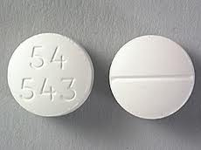
Exercise 1
A new drug is tested on three groups. Group A is given a double dose drug, group B is given a single dose of the drug, group C is given a placebo.
What is the IV?
How many conditions of the IV are there?
Which groups are experimental groups?
Which groups are control groups?
What is the experimental design of the study?

Slide 18
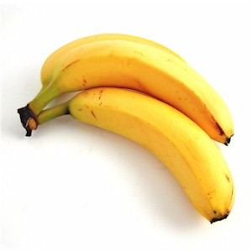
Exercise 2
A researcher conducts a test on the effect of bananas on the quality of sleep, comparing the depth of the sleep cycle after eating two bananas or no bananas.
What is the IV?
What is the DV?
Which experimental design would you use and why?
What is the experimental condition?
What is the control condition?

Slide 19
There are 3 types of experiment
GOING STRONG
 | Strength | Weakness
Laboratory | High controls ensure that you are testing the DV. Limits the affect of extraneous variables. | Demand characteristics Low in ecological validity.
Field | High in ecological validity. | Less control, so more likely to be affected by extraneous variables.
Quasi

Slide 20
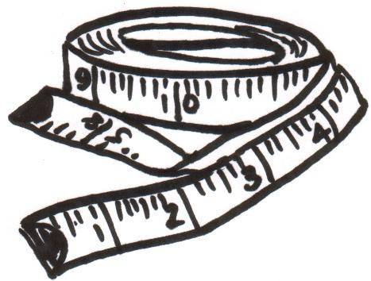
Experimental designs
There are two main types of experimental designs: independent measures and repeated measures.
Independent measures means that there are several groups that are tested separately and whose results are compared.
Repeated measures means that the same group is tested several times for different conditions of the IV.
The third type is called matched pairs design. This is when participants are arranged into pairs. Each pair performs one of the conditions of the IV.

Slide 21
What is meant by experimental design?
If you have decided that an experiment is the best approach to testing your hypothesis, then you need to design the experiment.
Experimental design refers to how participants are allocated to the different conditions (or IV groups) in an experiment.
GOING STRONG

Slide 22
Independent Group design
Different participants are used in each condition of the independent variable.
This means that each condition of the experiment includes a different group of participants.
This should be done by random allocation, which ensures that each participant has an equal chance of being assigned to one group or the other.
Independent measures involves using two separate groups of participants; one in each condition.
GOING STRONG

Slide 23
REPEATED MEASURES GROUP DESIGN
The same participants take part in each condition of the independent variable. This means that each condition of the experiment includes the same group of participants.
GOING STRONG

Slide 24
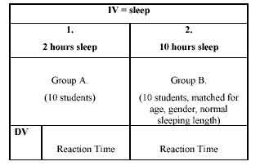
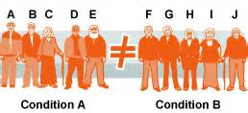
MATCHED PAIRS DESIGN
One pair must be randomly assigned to the experimental group and the other to the control group.
GOING STRONG

Slide 25
For each of the studies above, and answer the following questions
State the IV and the DV of the experiment
Name the conditions
State which experimental design has been used
Give one strengths and one weakness of that design in relation to the study.
A psychologist wants to test the theory that doctors have better spatial awareness than teachers. A group of doctors and teachers are given a series of spatial awareness tasks (such as rotating a cube in their heads, giving directions on a map etc.) which produces a spatial awareness score.
It is proposed that people are more willing to give money to a male rather than a female charity collector. This is tested by showing participants photographs of male and female faces and a description of a fake charity that they represent. The participants are then asked to say how much (if any) money they would donate.
A researcher is interested in the effect of marriage on general happiness in life. He measures the happiness of engaged people one year before their wedding, and then measures their happiness again one year after they have got married.

