Slide 2
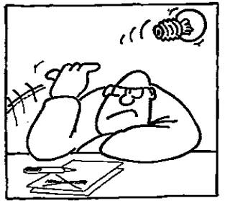
The Wilcoxon signed rank test
Component 01
Research Methods
L.O: To carry out a Wilcoxon Signed rank test and identify why it is carried out.

Slide 3
How will you know that you have made progress this lesson?
Progress Criteria
GOING STRONG
I can use the Wilcoxon Signed Rank test formula to calculate significance of a study.
ACCELERATING
I can explain how a Wilcoxon test is carried out and a critical value.
REVVING UP
I can explain the criteria needed to conduct a Wilcoxon Signed Rank Test

Slide 4
Checklist for using the Wilcoxon Signed Ranks Test
DV produces ordinal or interval type of data
Repeated Measures design
Exploring a difference between each condition (levels of the IV).
REVVING UP

Slide 5
Calculations example of Wilcoxon Signed Ranks Test
Psychologists were interested in knowing whether a group of students’ ability to memorise words was because of the ear that they used to hear the words during listening tasks. In order to investigate this, participants were individually presented with an audio recording of a list of words. These were randomly presented to the left or right ear. Participants gave two sets of scores – words remembered correctly from the left ear and words remember correctly from the right ear.
When the mean and standard deviation were calculated, it was found that the data was positively skewed which suggested that the data was not normally distributed. As a result, a Wilcoxon’s was used to examine the difference between each ear and to see if the difference did not occur by chance.
https://www.youtube.com/watch?v=xlgeta9FivI

Slide 6
Calculate the Wilcoxon value for this data
Participant number | 1 | 2 | 3 | 4 | 5 | 6 | 7 | 8 | 9 | 10 | 11 | 12
No. of correct answers to non-leading questions | 28 | 18 | 17 | 14 | 7 | 18 | 17 | 22 | 34 | 14 | 14 | 23
No. of correct answers to leading questions | 26 | 14 | 19 | 3 | 6 | 14 | 16 | 21 | 32 | 11 | 15 | 22
GOING STRONG

Slide 7
Match n value to the table of critical Wilcoxon Signed Ranks value. These values are found at the 0.05 significance level for two-tailed hypothesis.
N | 0.05
6 | 0
7 | 2
8 | 4
9 | 6
10 | 8
11 | 11
12 | 14
13 | 17
Notes:
N= 12

